Slide 1
Final Project-SQL
IPL AUCTION

Slide 2
Create a table and restore data in it

Slide 3
Create ipl_ball table:
Create ipl matches table:
create table ipl_matches(
id int,
city varchar, date diplomatese,
player_of_match varchar.
venue varchar,
neutral_venue int,
team1 varchar.
team2 varchar,
toss_winner varchar, toss_decision varchar, winner varchar, result varchar,
result_margin int,
eliminator varchar,
method varchar,
umpirel varchar,
umpire2 varchar);
set datestyle to "ISO,DMY“
copy ipl_matches from '/Applications/PostgreSQL 15/DATA/IPL matches.csv' CSV header;
CREATE TABLE ipl_ball_by_ball (
id INT,
inning INT,
over INT,
ball INT,
batsman VARCHAR,
non_striker VARCHAR,
batsman_runs INT,
is_wicket INT,
dismissal_kind VARCHAR,
player_dismissed VARCHAR,
fielder VARCHAR,
extras_type VARCHAR,
batting_team VARCHAR,
bowling_team VARCHAR
);
/Applications/PostgreSQL15/DATA/IPL_Ballcsv’ CSV header ;

Slide 4
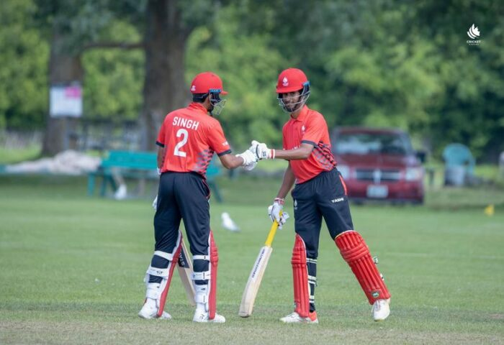
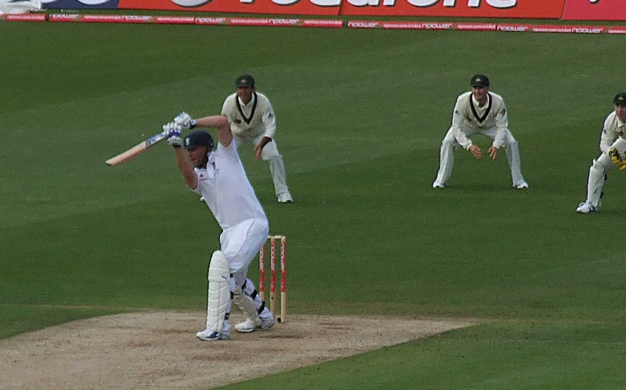
Bowler
Team Roles
Batsmen
All-Rounder

Slide 5

Batsman
HIGH S.R GOOD RVG
GOOD RVG
Hard Hitter
High Strike Rate
Faced atleast 500 seasons
Good Average
Played atleast 2 IPL seasons
High boundary percentage
Played atleast 2 IPLseasons

Slide 6

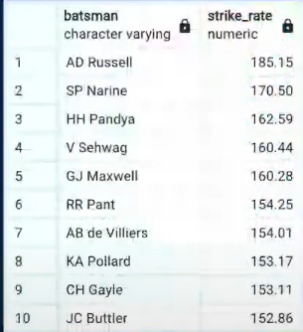
High Strike Rate
Result:
QUERY:
SELECTbatsman,ROUND((SUM(batsman_runs)/COUNT(ball))*100,2) AS strike_rateFROM
ipl_ballWHERE extras_type = 'NA'GROUP BY batsmanHAVING COUNT (ball)>500ORDER BY strike_rate DESCLIMIT 10;

Slide 7

High Strike Rate Batsman

Slide 8
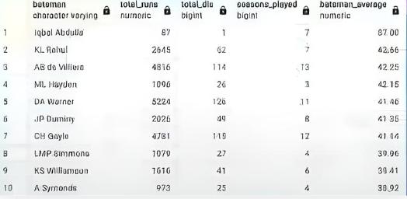
Good Average
Query
Result
  SELECT DISTINCTb.batsman,SUM(b.batsman_runs) AS total_runs,SUM (bis_wicket) AS total_dis,COUNT(DISTINCT(EXTRACT(YEAR FROM a.date})) ASseasons_played,ROUND{SUM(b.batsman_runs)/SUMIbis_wicket),2) ASpatsman_averageFROM ipl_matches AS aFULL JOIN ipl_ball AS bON alid=b.idWHERE extras_type= ‘NA’GROUP BY b.batsmanHAVING COUNT(DISTINCT(EXTRACT(YEAR FROM a.date)))>2 ANDNOT SUM(b.is_wicket)=0ORDER BY batsman_average DESCLIMIT 10;

Slide 9
Good Average Batsman

Slide 10
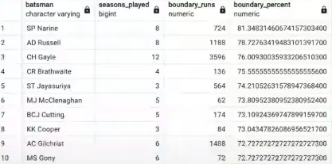
Hard Hitters
Query
SELECT DISTINCT b.batsman,
COUNT(DISTINCT(EXTRACT(YEAR FROM a.date))) AS
seasons played,
SUM(CASE WHEN b.batsman_runs = 4 OR b.batsman_runs = 6 THEN b.batsman_runs ELSE O END) AS boundary_runs, (SUM(CASE WHEN b.batsman_runs = 4 OR b.batsman_runs = 6 THEN b.batsman_runs ELSE 0 END)/ SUM(b.batsman_runs)) * 100 AS boundary_percent
FROM ipl_matches AS a
FULL JOIN ipl ball AS b ON a.id = b.id
WHERE extras_type = 'NA'
GROUP BY b.batsman
HAVING COUNT(DISTINCT(EXTRACT(YEAR FROM a.date))) > 2
ORDER BY boundary_percent DESC
LIMIT 10;
Result

Slide 11
Hard Hitter Batsman

Slide 12
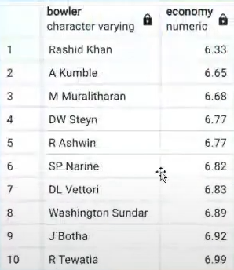
Good Economy Bowlers
Query
Result
SELECT bowler,
ROUND((SUM(total_runs)/(COUNT(bowler)/6.0)),2)
AS economy
FROM ipl ball
GROUP BY bowler
HAVING COUNT(bowler) >= 500
ORDER BY economy
LIMIT 10;

Slide 13
Good Economy Bowlers

Slide 14
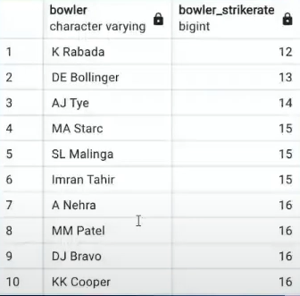
Good Bowler Strike Rate
Query:
SELECT bowler,
COUNT(bowler)/SUM(is_wicket) AS
bowler_strikeRate
FROM ipl ball
GROUP BY bowler
HAVING COUNT(bowler)>500 ORDER BY bowler_strikeRate LIMIT 10;
Result:

Slide 15
Good Strike Rate Bowlers

Slide 16
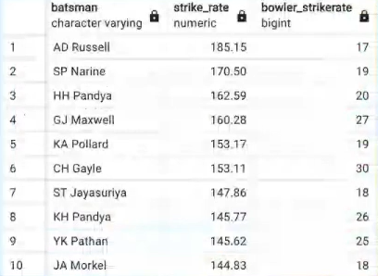
All rounder
Query:
Result:
SELECT batsman,
round((SUM(batsman_runs)/COUNT(ball))*100,2) AS strike_rate,
bowler_strikeRate
FROM ipl ball AS a
INNER JOIN(SELECT bowler,
COUNT(bowler)/SUM(is_wicket) AS bowler_strikeRate
FROM ipl ball
GROUP BY bowler
HAVING COUNT(bowler)>300
ORDER BY bowler_strikeRate ASC) AS b
ON a.batsman-b.bowler
WHERE extras_type='NA'
GROUP BY batsman,bowler_strikeRate
HAVING COUNT(ball)>500
ORDER BY strike_rate DESC, bowler_strikeRate ASC
LIMIT 10;

Slide 17
All-rounders
High Chances of bidding

Slide 18
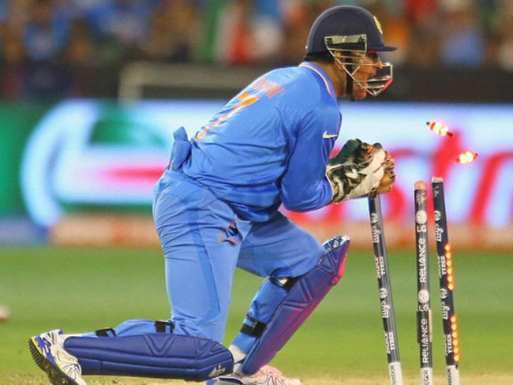
Wicketkeeping Criteria
For a wicketkeeper these things should be kept in mind:
Dismissals per Match: Average number of dismissals (catches and stumpings) per match.
Stumping Ability: Speed and efficiency of stumpings, especially against spinners.
Catching Efficiency: Consistency and reliability in taking catches.
Strike rate: Strike rate of a wicket keeper be high in the beginning.

Slide 19
Additional Questions
  Q1:
SELECT COUNT(DISTINCT city) AS total_cities
FROM matches;
Q2:
CREATE TABLE deliveries_v02 AS
SELECT *,
CASE
WHEN total_runs >= 4 THEN 'boundary'
WHEN total_runs = 0 THEN 'dot'
ELSE 'other'
END AS ball_result
FROM deliveries;

Slide 20
Q3
SELECT
COUNT(CASE WHEN ball_result = 'boundary' THEN 1 END) AS total_boundaries,
COUNT(CASE WHEN ball_result = 'dot' THEN 1 END) AS total_dot_balls
FROM deliveries_v02;
Q5:
SELECT
bowling_team,
COUNT(*) AS total_dot_balls
FROM deliveries_v02
WHERE ball_result = 'dot'
GROUP BY bowling_team
ORDER BY total_dot_balls DESC;
Q6:
SELECT
dismissal_kind,
COUNT(*) AS total_dismissals
FROM deliveries
WHERE dismissal_kind IS NOT NULL
GROUP BY dismissal_kind;
Q4
SELECT
batting_team,
COUNT(*) AS total_boundaries
FROM deliveries_v02
WHERE ball_result = 'boundary'
GROUP BY batting_team
ORDER BY total_boundaries DESC;

Slide 21
Q7
SELECT bowler,
SUM(extra_runs) AS total_extra_runs
FROM deliveries
GROUP BY bowler
ORDER BY total_extra_runs DESC
LIMIT 5;
Q9:
SELECT
venue,
SUM(total_runs) AS total_runs
FROM deliveries_v03
GROUP BY venue
ORDER BY total_runs DESC;
Q10:
SELECT
YEAR(match_date) AS year,
SUM(total_runs) AS total_runs
FROM deliveries_v03
WHERE venue = 'Eden Gardens'
GROUP BY YEAR(match_date)
ORDER BY total_runs DESC;
Q8
CREATE TABLE deliveries_v03 AS
SELECT d.*,
m.venue,
m.date AS match_date
FROM deliveries_v02 d
JOIN matches m ON d.match_id = m.id;

